Slide 1
Schunk Group @ CU Jour Fixe
17.01.2022, F. Reichert

Slide 2
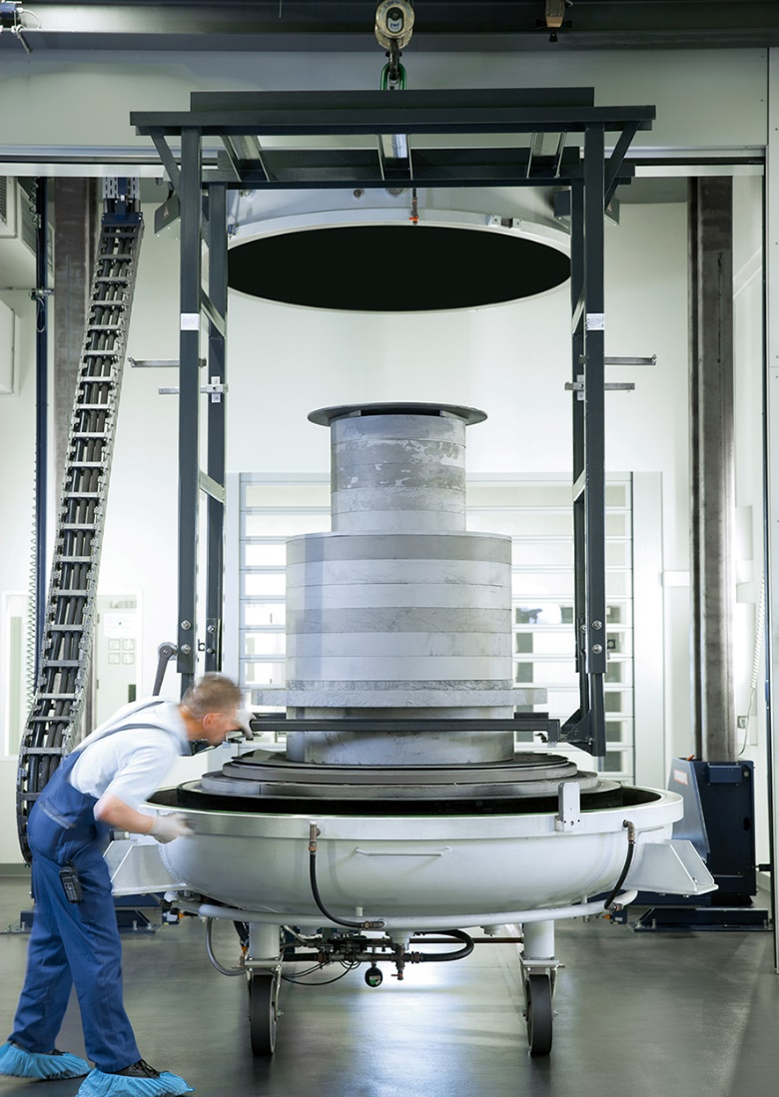
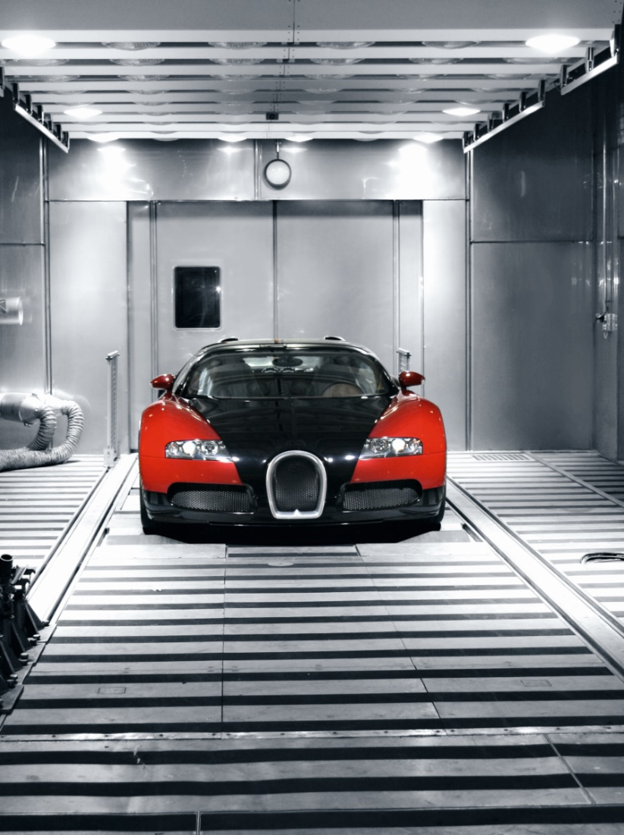
Schunk stands for excellent competence in materials and mechanical engineering
Our Competence
Materials engineering
Carbon
Ceramics
Fiber composites
Sinter Metals
Quartz
Mechanical engineering
Environmental simulation
Air-conditioning technology
Ultrasonic welding
Optical machinery
Examples of our competences
Surface finishing
Surface finishing by graphite coating with pyrolytic carbon
Dynamometer test chamber Testing chamber for complete vehicles for tests under defined environmental conditions

Slide 3
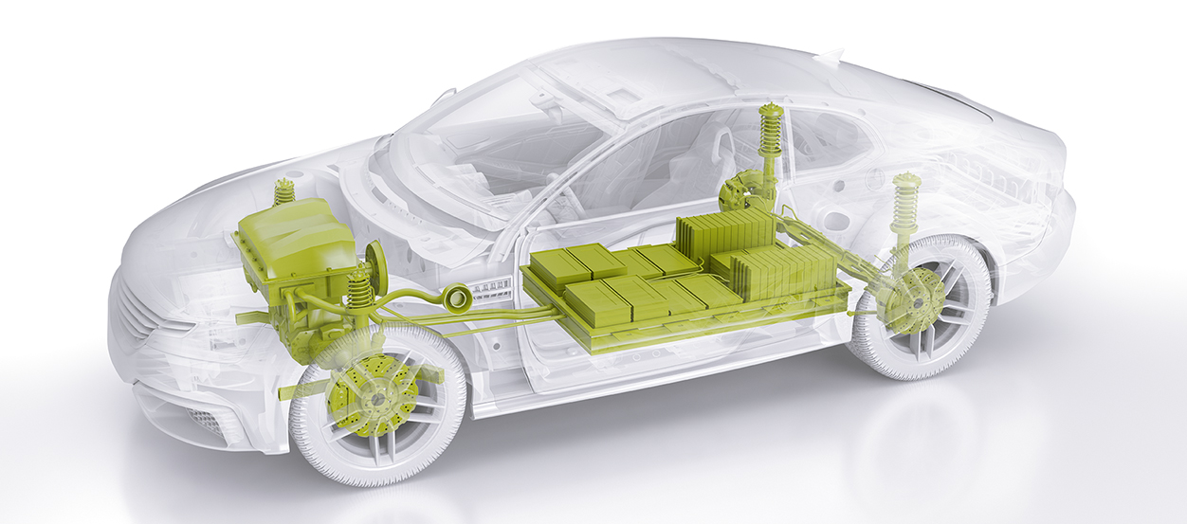
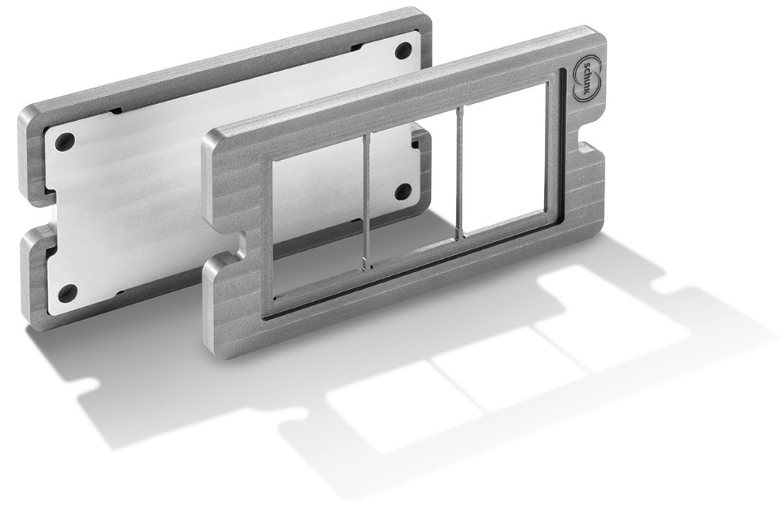
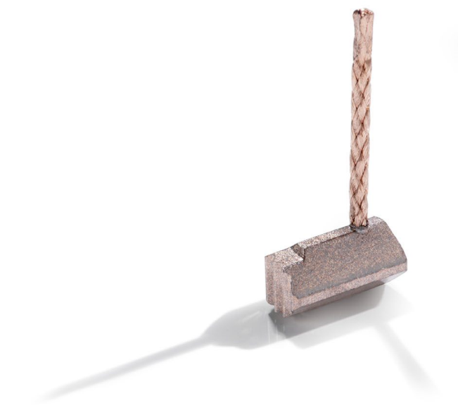
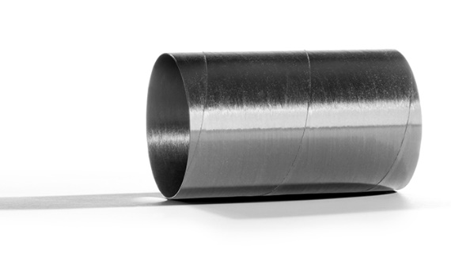
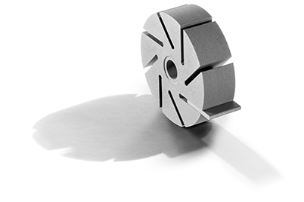
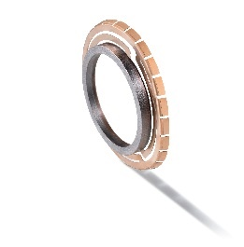
Innovative carbon products for the automotive industry
Business Unit Mobility Carbon
Applications
Engine and powertrain
Interior and safety
Battery technologies
Power electronics
Lightweight construction
E-engines
Carbon-reinforced and glass-fiber-reinforced armor sleeves for the electric motor
Vacuum pumps
Molded parts for vacuum pumps in brake boosters
Earthing systems
Contact systems for shaft earthing and for the electric drive train
Thermal management
Thermal management products for power electronics and battery modules
Electric motors
Carbon brushes for various drive motors
in the motor vehicle

Slide 4
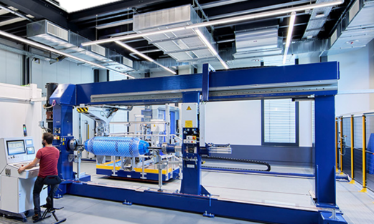
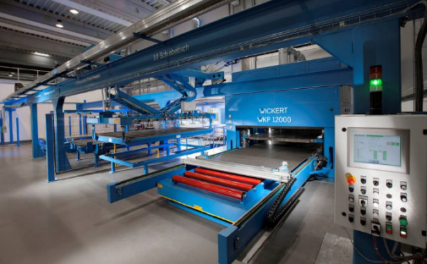
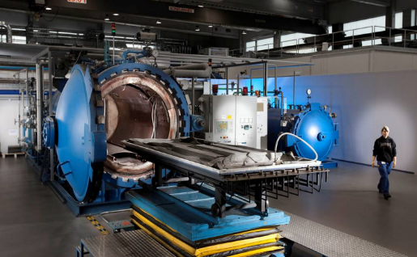
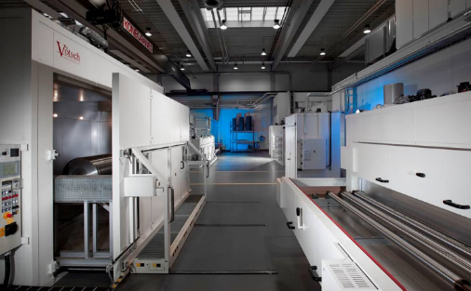
In-house competences for CFRP@ Schunk
CFRP manufacturing
High precision filament winding technology
4 winding machines; up to Ø 1,9m, l= 6,5 m
Pressing-technology
4 presses for prepreg- and SMC-parts up to 2 x 3 m², 12.000 kN
Autoclave technology
2 autoclaves; up to 1,80 x 2,50 m² , 45 bar, 500 °C
Curing furnaces
17 furnaces; up to 550 °C

Slide 5
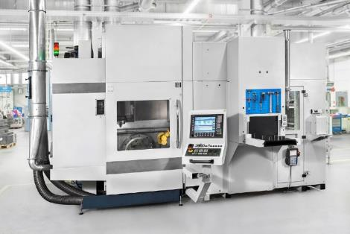
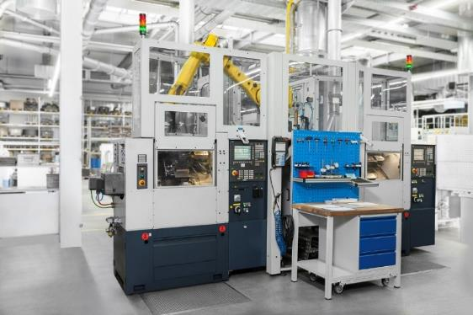
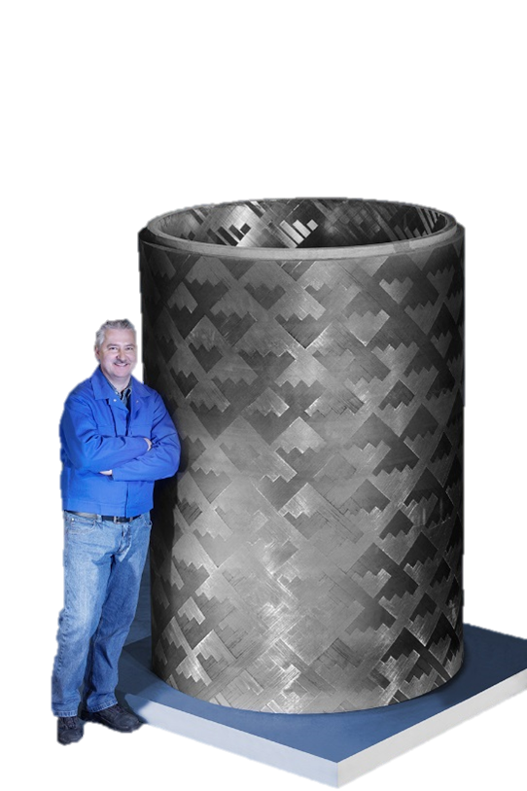
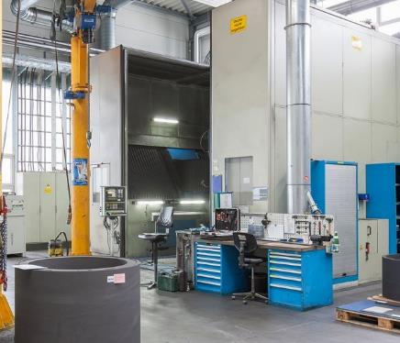
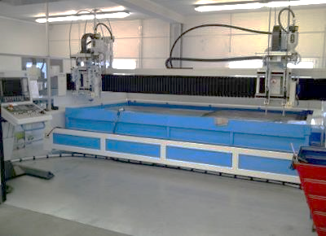
In-house competences for CFRP@ Schunk
Machining
Precision milling and turning centers with robot handling
Large milling and turning centers
Up to 3,0 x 2,2 x Ø 1,6 m³
Water-jet cutting
Up to 3,1 x 2,0 m³

Slide 6
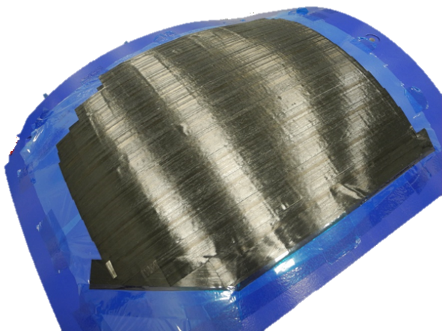
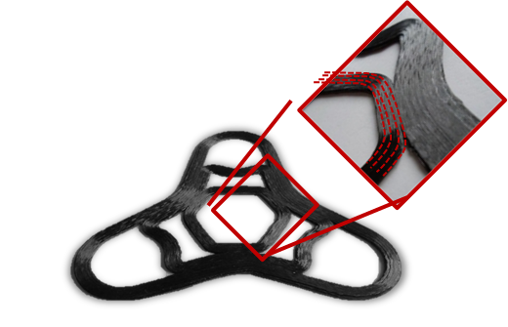
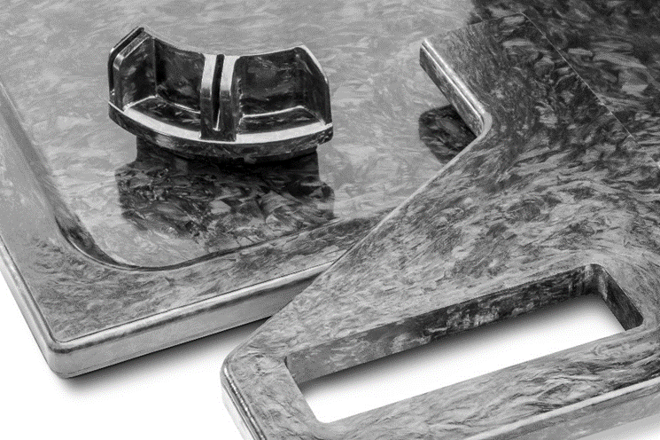
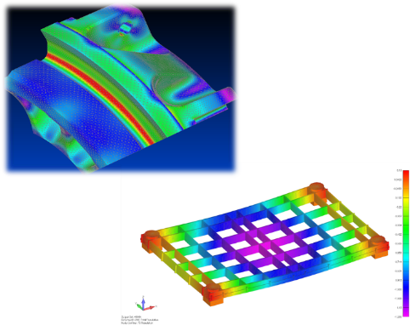
We are always interested in new ideas, processes and applications
Composites@Schunk: A material class full of ideas and possibilities
Thermoplastics
Additive manufacturing
SMC technology
Automated tape laying
Surface modification, joining processes and multi-material lightweight design
Full-service provider

Slide 7
Schunk Group
Rodheimer Straße 59
35452 Heuchelheim ¬ Deutschland
Tel +49 641 608 0
info@schunk-group.com
schunk-group.com
21/06/09

